Slide 1
Pollutant Emissions in the US
From the emission trends over the span of 20 years, what are the future pollutant levels for 2023?
Group 3: Kate Lee, Shiho Ikeda, ShukFong Yu
Link to GitHub Repository:
https://github.com/yamaseraph/Air-Pollutant-Analysis
Notes:
We are Group 3 and our focus will be on Air Quality Index.

Slide 2
Essential Question
How can the process of creating AI/ML solutions amplify or mitigate bias in the case our team is using?
There may be some amplified bias in the prediction of emissions as our data as there are nuances outside of our dataset that affects these levels (i.e. COVID)
For prediction, bias can be mitigated in by modifying our data before feeding it to the model (such as transforming and validating). Bias can be further mitigated if it was used with other factors of emissions, such as residential activity, technological developments, vehicles, etc.

Slide 3
Project Description
Project Description:
This project focuses on analyzing previous air pollutant trends from different states and industries in the US.
These values are then used in the ARIMA model to forecast the future pollutant levels for 2023
CO
NH3
NOX (nitrous oxides)
SO2
PM10
PM2.5
Notes:
Our project focuses on using past pollutant and emissions data.
By analyzing the data from previous years (2002-2022), we would predict the values for 2023.

Slide 4
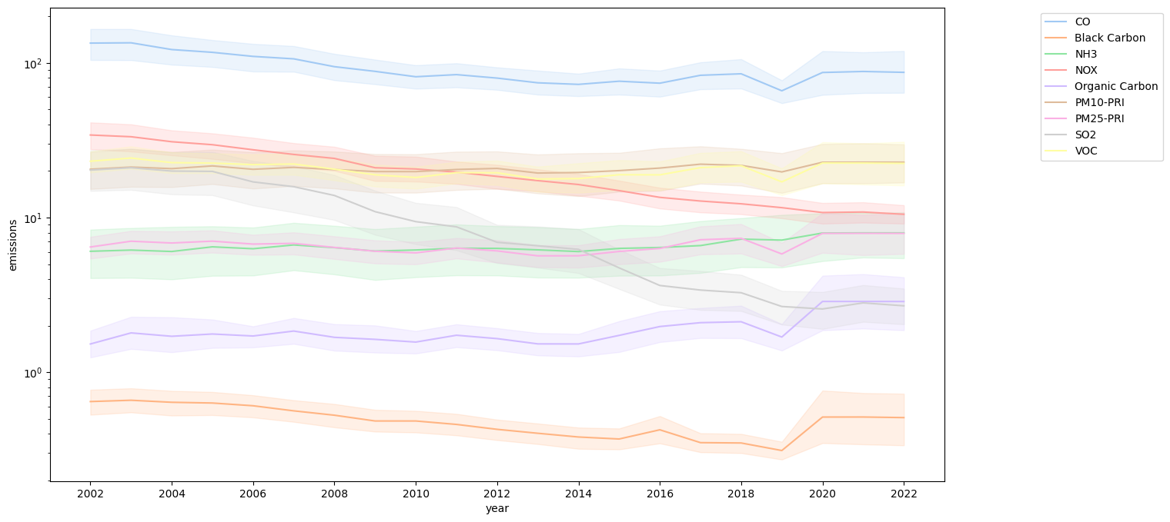
Data Visualization (Emissions over Time)
This graph shows corresponding emissions by year.
Y-axis: Emission levels
X-axis: Years 2002-2022
Colored lines: Different pollutants
CO seems to be very prevalent compared to other pollutants
Black Carbon appears to have less emissions
Notes:
Probably need to address the sudden curve in the most of emissions on 2019, due to the pandemic.
This resulted in predicting the emissions more difficult.

Slide 5
Algorithm Used: ARIMA
AutoRegressive Integrated Moving Average (ARIMA)
Utilizes time series data (data collected over time) to predict current/future values
3 parameters (AR, I, MA) or (p,d,q):
AutoRegressive (AR or p): number of past values to predict current
Ex. p=2 → model uses last 2 previous values to predict
Integrated (I or d): difference between current and previous values to make it stationary
Stationary: constant mean, variance, and autocorrelation over time
Ex. d=1→ data is subtracted from previous value once
Ex. d=2→ data is subtracted from previous value twice
Moving Average (MA or q): number of past errors to correct current value prediction
Ex. q=0→ model does not use any errors to adjust prediction
Ex. q=2→model uses previous two errors to adjust
You can find parameters with “Grid Search”, where parameters are evaluated and the parameters with the least error difference is chosen (our model uses 5,1,0)
Notes:
ARIMA, or Auto Regressive Integrated Moving Average, is a model that is used for forecasting data that changes over time.
It uses time series data to predict current or future values.
There are 3 parameters (AR, I, and MQ) or (p,d,q)
Autoregressive (p) is the number of past values of data used to predict the current value.
For example, if p=2 uses the last 2 previous values
Integrated (d) is the difference between the current and previous values to make it stationary
Stationary means that there is constant mean, variance and autocorrelation over time
If d is 1, then the data is subtracted from the previous value once, and if d is 2, then it is subtracted twice
Moving Average (q) is the number of past errors of the prediction used to correct the current prediction
If q is 2, then the model used the last two values to adjust
To find the best (p,d,q) parameters, you can use Grid Search. This evaluates different sets of parameters and chooses the best fitting one based on the lowest error difference. Our model uses (5,1,0).

Slide 6
ARIMA Algorithm Inputs and Outputs
Type of algorithm: Supervised
Supervised learning: “induce models from these training data and these model scan be used to classify other unlabelled data” (Cunningham et al.)
ARIMA uses past values to predict current
Inputs:
Data (CSV File containing States, Industries, Pollutants, Emissions (by year))
Outputs:
Prediction of future values of time series (based on past values )
Our model: Predicted level of emission for year (2023)
Notes:
As you can probably tell, ARIMA is a supervised algorithm. It uses past values to predict current or future values.
The input is the data. In this case, it is our csv file that was cleaned and transformed.
The output is the prediction of the future or current value. Our output is the predicted level of emission for 2023.

Slide 7
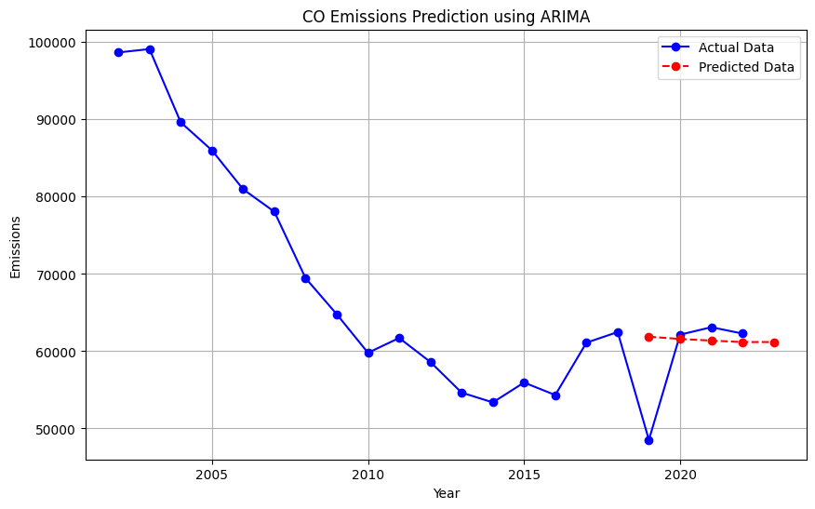
Evaluation of model (Carbon Monoxide - CO)
Years | Predicted Emissions | Actual Emissions | Residual (Predicted-Actual)
2019 | 61879 | 48524 | 13354
2020 | 61585 | 62146 | -561
2021 | 61374 | 63105 | -1731
2022 | 61182 | 62284 | -1102
2023 | 61192 | N/A | N/A
Note: These values are rounded to the nearest integer
Note: Official Units: Emissions in 1000/tons
Notes:
Here, we have a model of predicted and expected values of emission for carbon monoxide in a thousand per tons
The blue is the actual data, and the red is our predicted.
We can see how it compares by looking at the residual, which is the difference between the predicted and subtracted values.
The residual value for the first year (2019) is positive, meaning that the predicted value was higher than the actual emissions.
The other years 2020-2022 have a negative residual value, telling us that the predicted value was lower than the actual.
We predicted the emissions for 2023 to be 61,192. There is no residual for 2023 because we do not have any actual 2023 data to compare it to.
We can see that there is large difference between 2019’s predicted and actual values.
This is because the ARIMA model is sensitive to recent points and essentially just follows the pattern of previous points.
Because covid hit, there was a significant drop of emissions in 2019.
The model is unable to account for discrepancies like unexpected diseases or actual phenomena, so the predicted value for 2019 was what would have been expected had covid not been a thing.

Slide 8
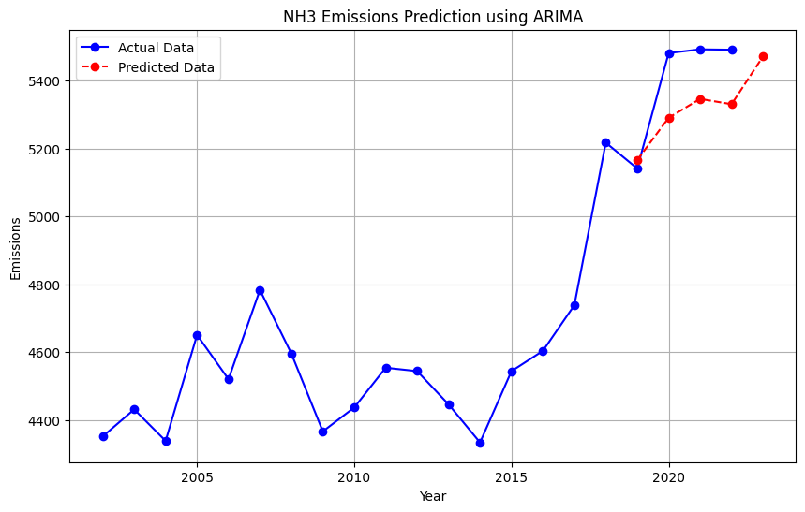
Evaluation of model (Ammonia - NH3)
Years | Predicted Emissions | Actual Emissions | Residual (Predicted-Actual)
2019 | 5166 | 5141 | 25
2020 | 5290 | 5481 | -191
2021 | 5346 | 5492 | -146
2022 | 5330 | 5491 | -160
2023 | 5471 | N/A | N/A
Note: These values are rounded to the nearest hundredth
Note: Official Units: Emissions in 1000/tons
Notes:
Similarly, we can take a look at Ammonia’s results.
The predicted value for 2019 is around 5471 in emissions thousands per tons.
Again, we see that the residual is positive for 2019 as the prediction is higher than the actual.
And the residuals for 2020-2022 are negatives because they are lower than the expected values.

Slide 9
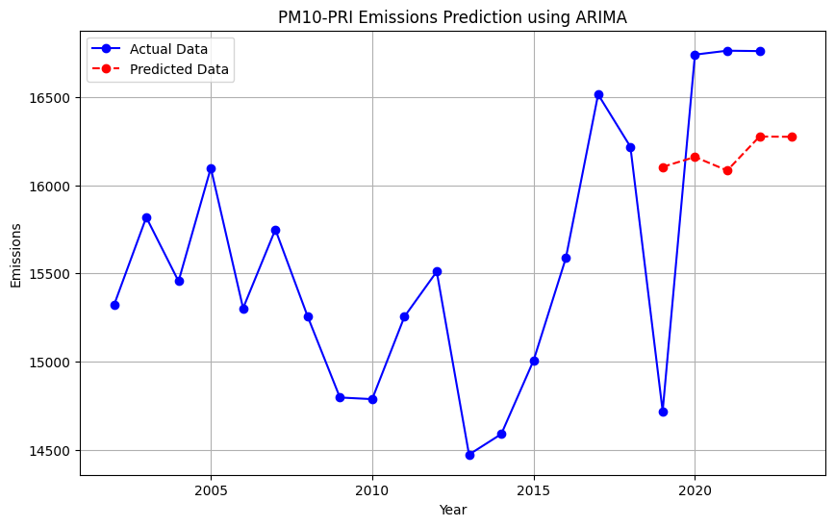
Evaluation of model (Particulate Matter 10 - PM10 )
Years | Predicted Emissions | Actual Emissions | Residual (Predicted-Actual)
2019 | 16104 | 14719 | 1386
2020 | 16161 | 16741 | -581
2021 | 16084 | 16763 | -679
2022 | 16376 | 16761 | -485
2023 | 16275 | N/A | N/A
Note: These values are rounded to the nearest hundredth
Note: Official Units: Emissions in 1000/tons
Notes:
For Particulate Matter 10, the prediction for 2023 is 16,275.
As with the other models, the predicted emission for 2019 is higher than the actual
, while the 2020-2022 predictions are lower.
Here again, we see the same significant difference in predicted vs actual emissions for 2019 due to the outside variable of covid that ARIMA cannot account for.

Slide 10
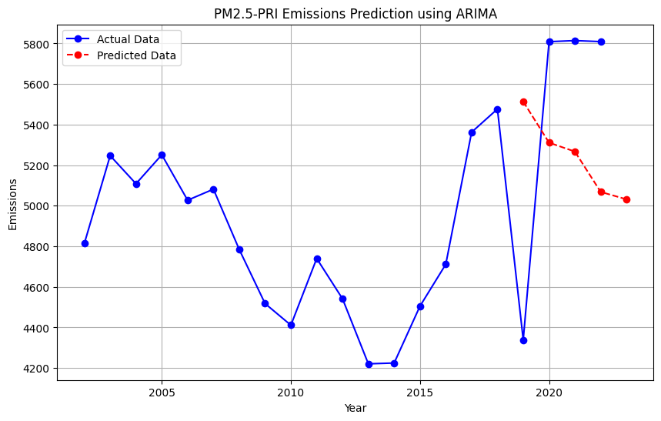
Evaluation of model (Particulate Matter 2.5- PM2.5)
Years | Predicted Emissions | Actual Emissions | Residual (Predicted-Actual)
2019 | 5513 | 4339 | 1175
2020 | 5311 | 5809 | -498
2021 | 5267 | 5814 | -547
2022 | 5068 | 5809 | -740
2023 | 5032 | N/A | N/A
Note: These values are rounded to the nearest hundredth
Note: Official Units: Emissions in 1000/tons
Notes:
The prediction for 2023’s particulate matter 2.5 is 5,032 emissions in thousands per tons.
The residual follows the same pattern as the other models, higher prediction for 2019, lower for 2020 through 2023.

Slide 11
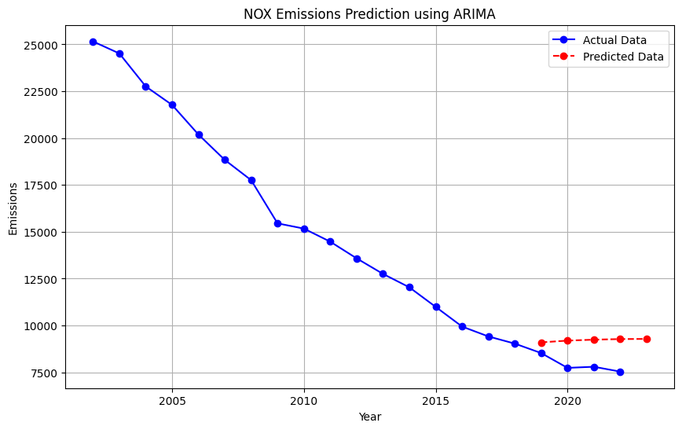
Evaluation of model (Nitrous Oxides- NOX)
Years | Predicted Emissions | Actual Emissions | Residual (Predicted-Actual)
2019 | 9099 | 8530 | 570
2020 | 9193 | 7738 | 1454
2021 | 9244 | 7798 | 1446
2022 | 9275 | 7539 | 1737
2023 | 9283 | N/A | N/A
Note: These values are rounded to the nearest hundredth
Note: Official Units: Emissions in 1000/tons
Notes:
For Nitrous Oxide, we predicted the emission value to be 9,283 for 2023.
The model predicted higher values than the actual values for all years 2019 to 2023.

Slide 12
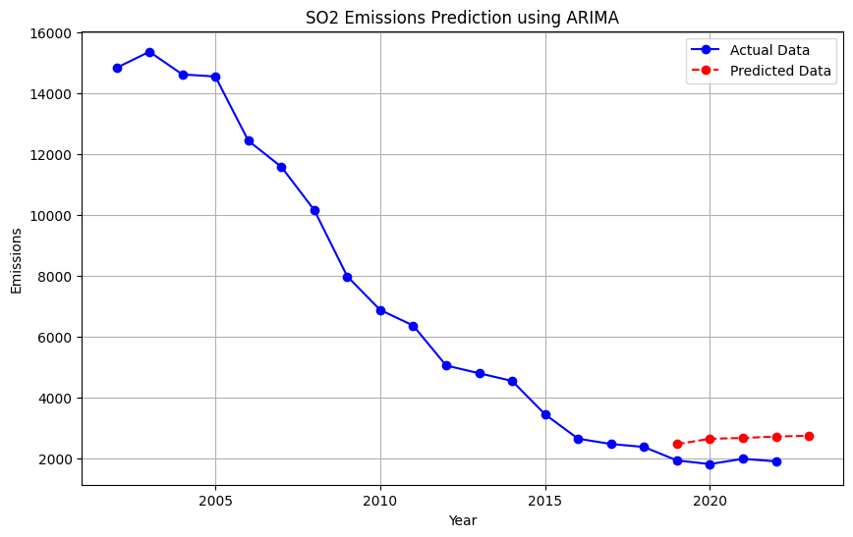
Evaluation of model (Sulfur Dioxide- SO2)
Years | Predicted Emissions | Actual Emissions | Residual (Predicted-Actual)
2019 | 2481 | 1945 | 536
2020 | 2656 | 1827 | 829
2021 | 2683 | 1999 | 684
2022 | 2729 | 1915 | 814
2023 | 2757 | N/A | N/A
Note: These values are rounded to the nearest hundredth
Note: Official Units: Emissions in 1000/tons
Notes:
With the sulfur dioxide model, the residuals are also higher since the predicted level of emissions are more than the actual.
For 2023, we predicted the emission level for sulfur dioxide to be 2,757.

Slide 13
Project Evolution
Evolution:
Began by cleaning up original csv data (State_Trends)
Faced errors for columns and categories during pre-processing
Transformed data by melting emissions year into years, then combining sums for pollutants
Visualized emissions over time by plotting years (x), emissions (y)
This is done to view trends and any correlations between values (emissions, states, years, industries)
Utilized ARIMA for forecasting
Testing accuracy for using previous years
Based on this accuracy and comparison, continued to use model to predict for 2023

Slide 14
Positive and Negative Impacts of our Work
Positive
Negative
Can help raise awareness and resources to support climate action
Helps inform policy makers and businesses to plan for action
Prioritize which areas need most work (in terms of pollutants)
Finer levels of data
Is not 100% accurate, no guarantee or certainty
May be miscommunicated or not properly interpreted by audience
Information may be misused for inaction, which can worsen the climate for the future
Notes:
If finer levels of data, can identify where gov and companies are failing to look after public safety
different geographic area may have disproportionately worser emissions than other areas)
i.e. lower income areas
Negative: Forecasting is very difficult, economists have been forecasting state of economies and recessions and even then, the predictions have been difficult to come true

Slide 15
Next steps
If possible, we our team can try training the model’s prediction accuracy.
Get more points to train
Explore ways to address bias in data for areas that were not covered
Expanding what other factors influence emissions other than industries and pollutants

Slide 16
Citations:
Bouza, E., Vargas, F., Alcázar, B., Álvarez, T., Asensio, Á., Cruceta, G., Gracia, D., Guinea, J., Gil, M. A., Linares, C., Muñoz, P., Olier, E., Pastor, P., Pedro-Botet, M. L., Querol, X., Tovar, J., Urrutia, I., Villar, F., & Palomo, E. (2022). Air pollution and health prevention: A document of reflection. Revista Española de Quimioterapia, 35(4), 307–332. https://doi.org/10.37201/req/171.2021
Brownlee, J. (2020, December 9). How to grid search arima model hyperparameters with python. MachineLearningMastery.com. https://machinelearningmastery.com/grid-search-arima-hyperparameters-with-python/
Brownlee, J. (2023, November 18). How to create an Arima model for time series forecasting in Python. MachineLearningMastery.com. https://machinelearningmastery.com/arima-for-time-series-forecasting-with-python/
Cunningham, P., Cord, M., & Delany, S. J. (2008). Supervised learning. In Machine learning techniques for multimedia: case studies on organization and retrieval (pp. 21-49). Berlin, Heidelberg: Springer Berlin Heidelberg.
Gupta, N. S., Mohta, Y., Heda, K., Armaan, R., Valarmathi, B., & Arulkumaran, G. (2023). Prediction of air quality index using Machine Learning Techniques: A Comparative Analysis. Journal of Environmental and Public Health, 2023, 1–26. https://doi.org/10.1155/2023/4916267
Learnerea. (2022, December 8). Time series analysis using Python| Arima & SARIMAX model implementation | stationarity handling. YouTube. https://www.youtube.com/watch?v=O5pataOw33Y
Source of Data (EPA State Tier 1 CAPS Trends (xlsx)): https://www.epa.gov/air-emissions-inventories/air-pollutant-emissions-trends-data
Link to GitHub Repository:
https://github.com/yamaseraph/Air-Pollutant-Analysis

